Slide 1

Natural Language Processing
A Comprehensive Journey into NLP Techniques and Applications
Dated: 12 July 2025
Instructor : Fawad Bahadur

Slide 2

Training Objectives & Outcomes
1
Core NLP concepts and terminologies.
2
Techniques for text preprocessing and analysis.
3
Building NLP models using popular libraries.
4
Advanced topics like topic modeling and deep learning in NLP.
Instructor : Fawad Bahadur

Slide 3
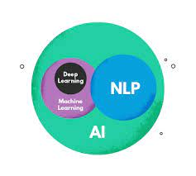
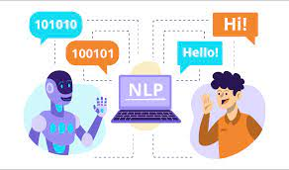
What is Natural Language Processing (NLP)?
Definition:
Natural Language Processing (NLP) is a field of Artificial Intelligence (AI) that enables computers to understand, interpret, and generate human language.
Goals of NLP:
Bridge communication between humans and machines
Enable machines to understand context, semantics, and intent
Automate and enhance language-based tasks

Slide 4
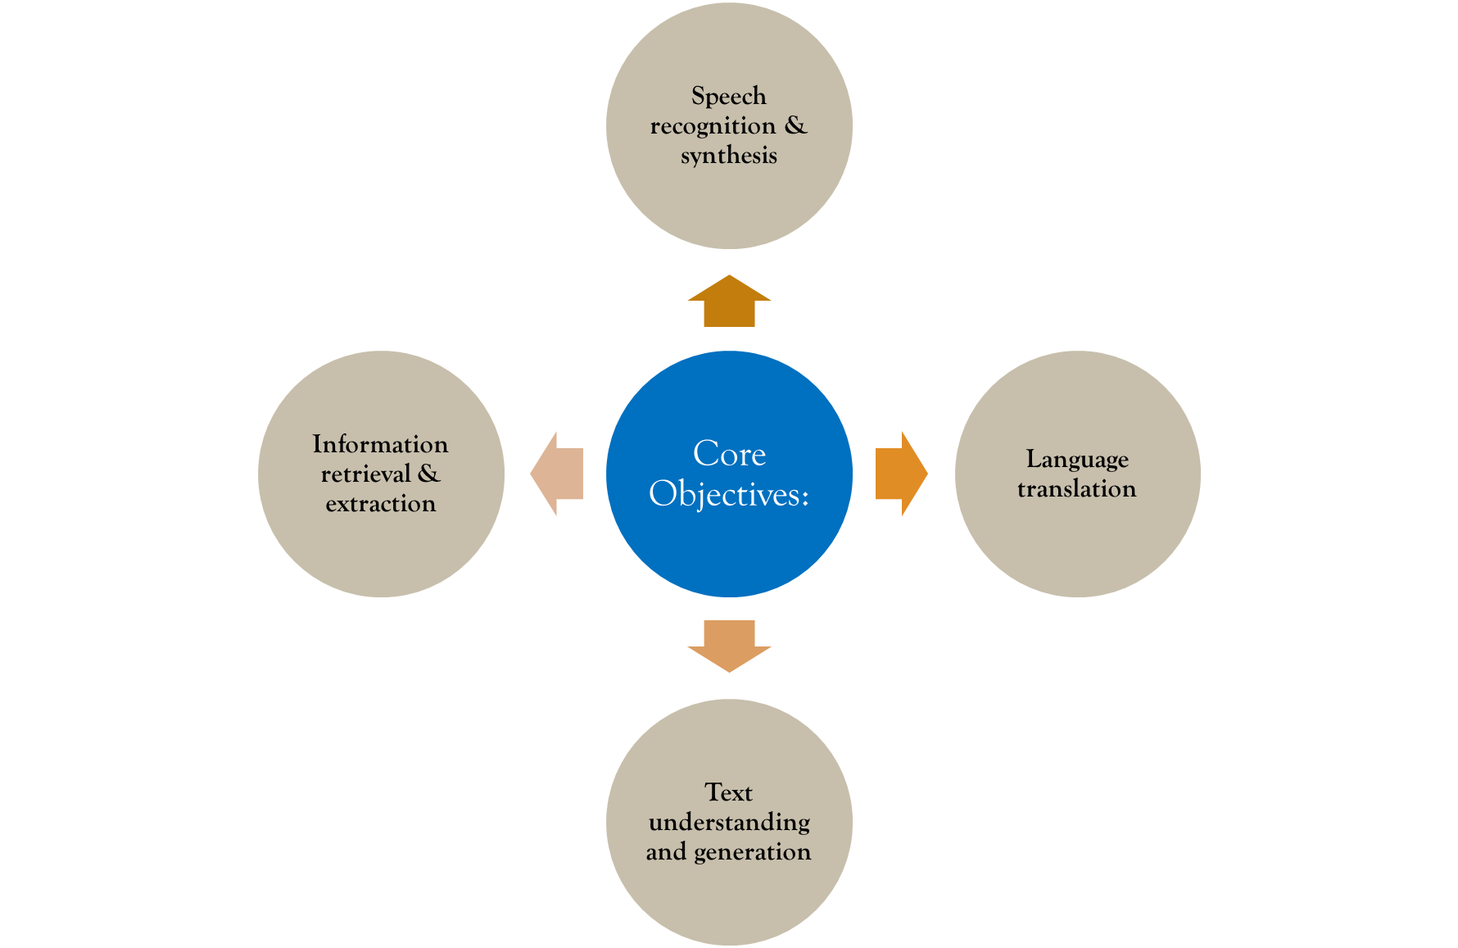
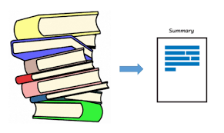
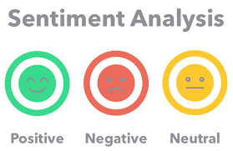

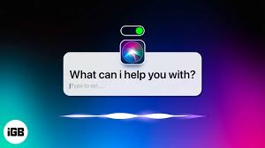
What is Natural Language Processing (NLP)?
Core Objectives:
Speech recognition & synthesis
Language translation
Text understanding and generation
Information retrieval & extraction
Key Applications:
Chatbots & Virtual Assistants (e.g., , Alexa)
Machine Translation (e.g., Google Translate)
Sentiment Analysis (e.g., product reviews)
Text Summarization
Email classification (spam detection)
Search engines

Slide 5
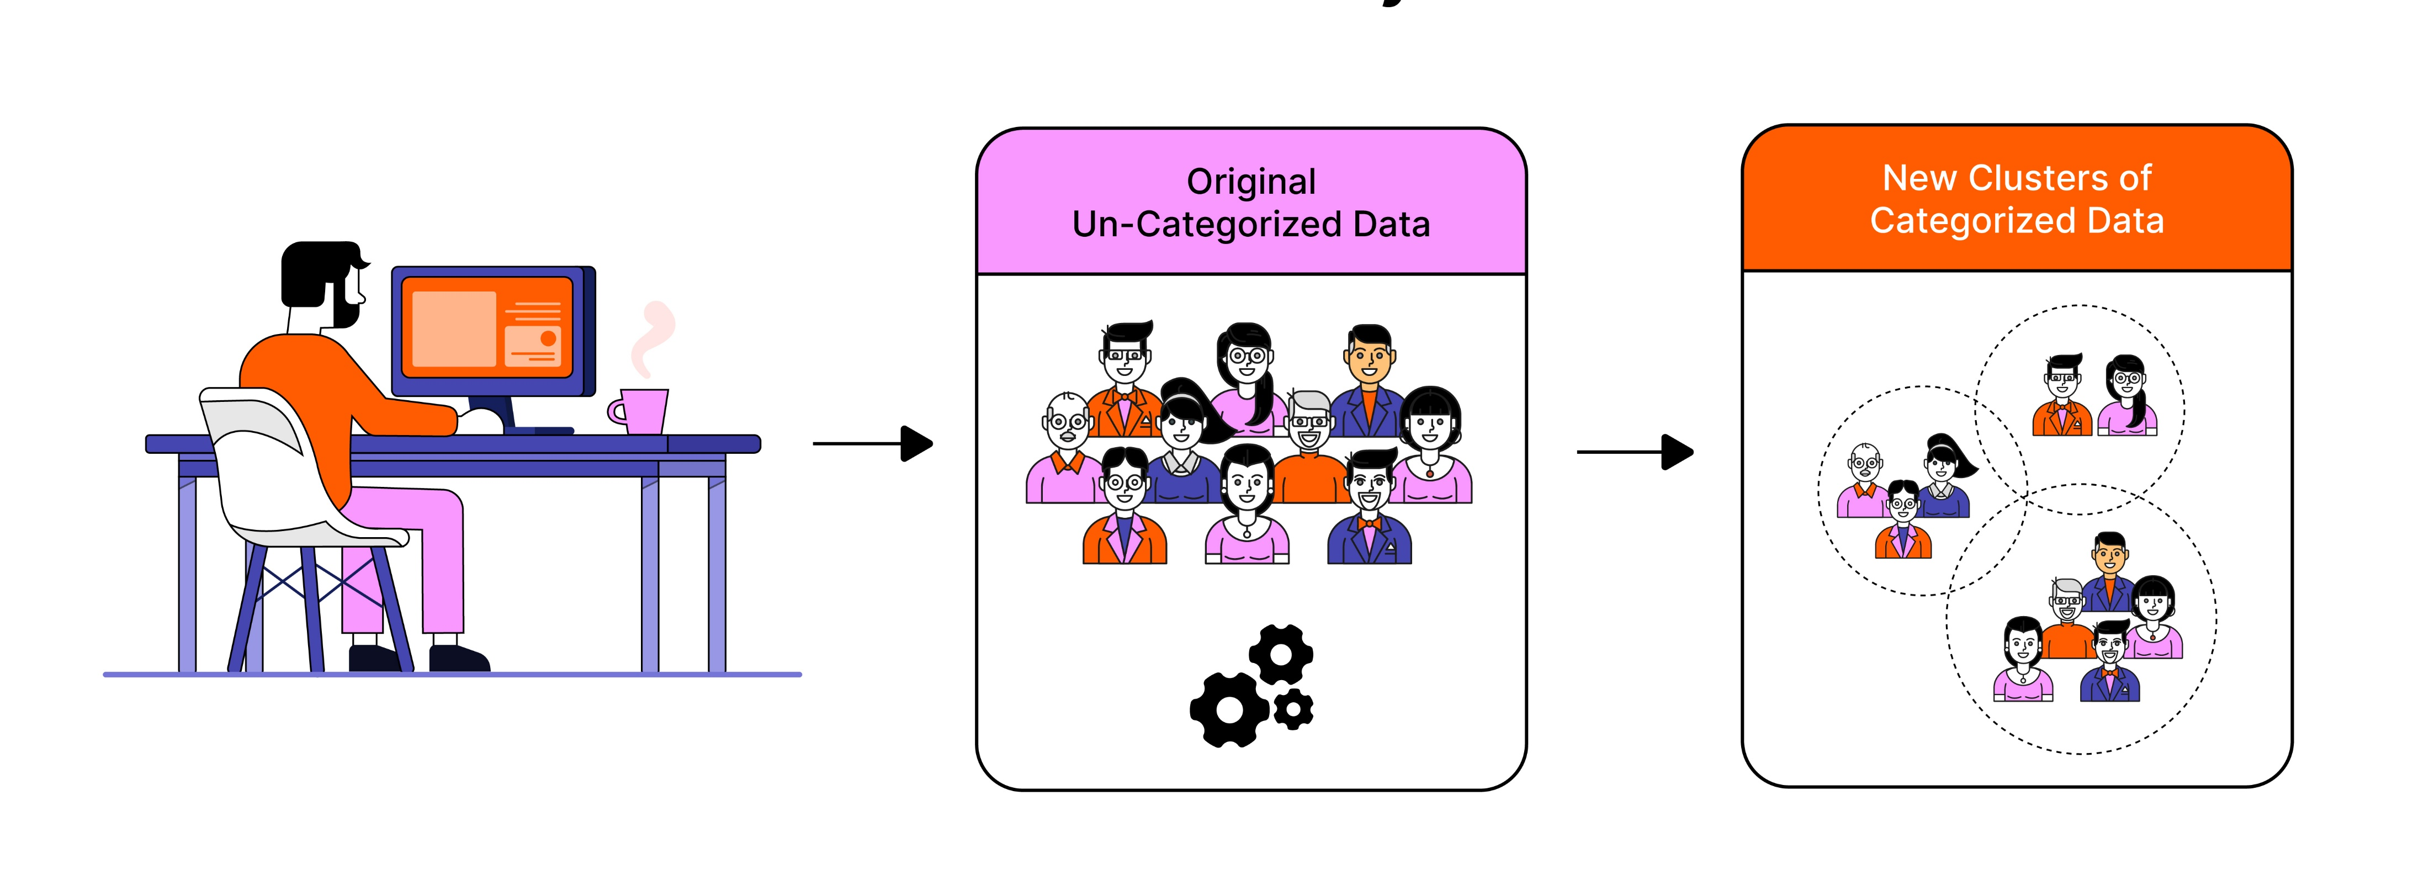
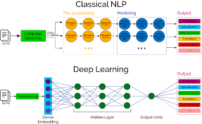
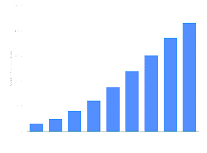
Brief History of NLP
1950s–1960s: Rule-Based Systems
Alan Turing proposes the Turing Test (1950)
First attempts at machine translation
NLP based on hand-written rules and grammar structures
1970s–1980s: Classical Linguistics & Symbolic NLP
Development of syntactic parsers
Use of expert systems
Limited success due to complexity and ambiguity of language
1990s: Statistical NLP
Introduction of machine learning techniques
Use of Hidden Markov Models (HMMs) and n-grams
Rise of data-driven approaches using large corpora

Slide 6
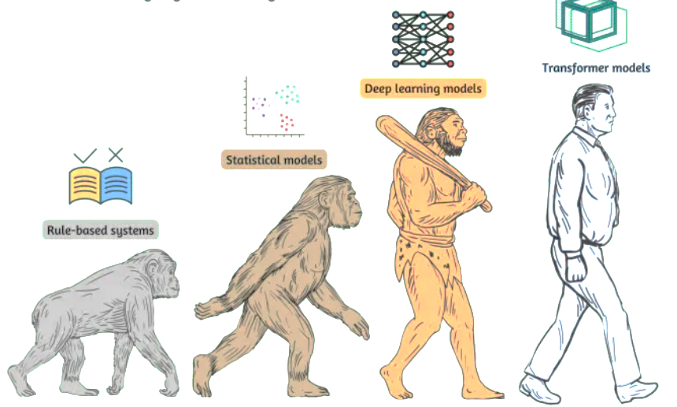
Brief History of NLP
2000s–2010s: Deep Learning Era
Emergence of word embeddings (e.g., Word2Vec, GloVe)
NLP powered by Neural Networks and Recurrent Neural Networks (RNNs)
Significant improvement in accuracy and scale
2018–Present: Transformers and Large Language Models (LLMs)
Introduction of Transformers (Vaswani et al., 2017)
Rise of BERT, GPT, T5 and other LLMs
Shift to pretrained models and transfer learning

Slide 7


Challenges and Ambiguities in Natural Language
1. Ambiguity
Lexical Ambiguity: One word with multiple meanings
E.g., “bat” (animal vs. sports equipment)
Syntactic Ambiguity: Multiple possible sentence structures
E.g., “I saw the man with the telescope”
Semantic Ambiguity: Ambiguity in meaning
E.g., “The chicken is ready to eat” (Who’s eating whom?)
2. Context Sensitivity
Language meaning depends on context, tone, culture, etc.
E.g., sarcasm, irony, or slang

Slide 8
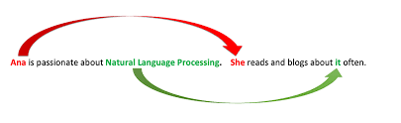

Challenges and Ambiguities in Natural Language
3. Coreference Resolution
Identifying what a pronoun or noun refers to
E.g., “John helped Ali because he was tired”
4. World Knowledge
NLP models lack real-world understanding
E.g., “She put the book on the table and sat on it”

Slide 9
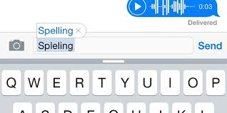
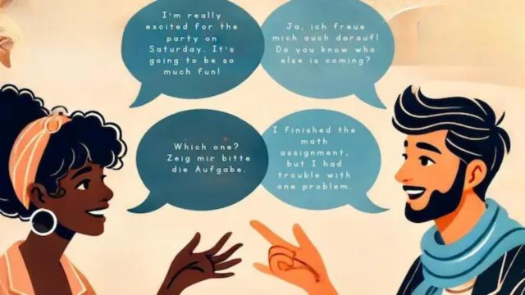
Challenges and Ambiguities in Natural Language
5. Spelling & Grammar Variations
Informal writing, typos, abbreviations
E.g., “u” vs. “you”, “gonna” vs. “going to”
6. Multilinguality & Code-Switching
Handling multiple languages or mixed language text
E.g., “Main office jaa raha hoon” (English + Urdu/Hindi)

Slide 10

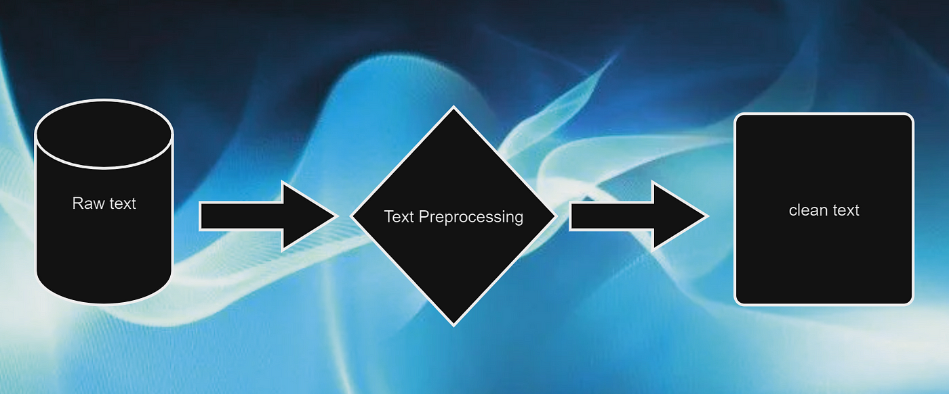
The NLP Pipeline – Overview of Common Steps
1. Text Collection
Gather raw text data from sources like web, documents, chats, etc.
2. Text Preprocessing
Tokenization: Splitting text into words/sentences
Lowercasing: Converting all text to lowercase
Stopword Removal: Removing common non-informative words
Stemming/Lemmatization: Reducing words to root forms
Noise Removal: Removing punctuation, numbers, HTML tags, etc.

Slide 11
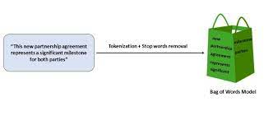
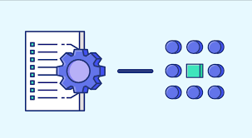

The NLP Pipeline – Overview of Common Steps
3. Text Representation
Bag of Words (BoW)
TF-IDF
Word Embeddings (Word2Vec, GloVe, BERT)
4. Feature Engineering
Creating features that represent key information from the text
5. Model Building
Classification (e.g., spam detection)
Clustering (e.g., topic modeling)
Sequence Modeling (e.g., language generation)

Slide 12
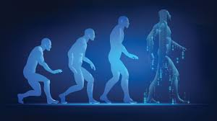

The NLP Pipeline – Overview of Common Steps
6. Evaluation
Using metrics like Accuracy, Precision, Recall, F1-Score
7. Deployment
Integrating trained model into applications or APIs

Slide 13

Introduction to Core NLP Libraries
1. NLTK (Natural Language Toolkit)
One of the oldest NLP libraries in Python
Great for learning & prototyping
Offers tools for tokenization, POS tagging, parsing, and more
Rich collection of linguistic datasets
Use Case: Academic projects, initial NLP exploration
Instructor : Fawad Bahadur

Slide 14

Introduction to Core NLP Libraries
2. spaCy
Fast, production-ready NLP library
Supports named entity recognition (NER), POS tagging, dependency parsing
Pre-trained pipelines for multiple languages
Easy integration with deep learning frameworks
Use Case: Industrial NLP tasks, pipelines in production

Slide 15

Introduction to Core NLP Libraries
3. Hugging Face Transformers
Leading library for transformer-based models (BERT, GPT, RoBERTa, etc.)
Supports fine-tuning and inference with minimal code
Access to large-scale pre-trained models via transformers & datasets packages
Use Case: State-of-the-art tasks like text generation, summarization, question answering
Instructor : Fawad Bahadur

Slide 16



Introduction to Core NLP Libraries
4. Others (Brief Mentions)
TextBlob: Simple API for common NLP tasks
Gensim: Topic modeling and Word2Vec
Flair: NLP by Zalando with strong sequence labeling support

Slide 17

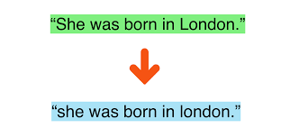
Text Cleaning — Case Folding, Punctuation, Numbers
Objective:
Prepare raw text data for NLP tasks by removing noise and standardizing input.
1. Case Folding (Lowercasing)
Converts all text to lowercase
Reduces vocabulary size
Example:
"Apple" → "apple“
Ensures “Apple” and “apple” are treated the same

Slide 18
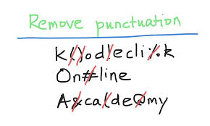
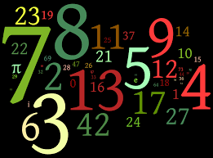
Text Cleaning — Case Folding, Punctuation, Numbers
2. Removing Punctuation
Eliminates special characters like . , ! ? : ; etc.
Punctuation often does not add meaning (except in sentiment or emotion detection)
Example:
"Hello, world!" → "Hello world"
3. Removing Numbers
Numbers may be irrelevant in some NLP tasks (e.g., sentiment analysis)
In other contexts (e.g., financial or scientific texts), they may be retained
Example:
"There are 123 apples" → "There are apples"
Note:
Always tailor cleaning to your task.
Don’t over-clean if the information might be useful (e.g., "COVID-19", "Windows 10")

Slide 19

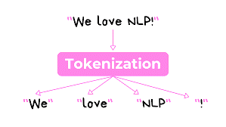
Tokenization — Word, Sentence, and Subword Tokenization
Definition:
Tokenization is the process of splitting text into smaller units (tokens), which are the building blocks for NLP tasks.

Slide 20
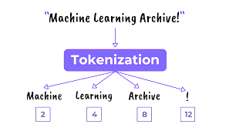
Tokenization — Word, Sentence, and Subword Tokenization
1. Word Tokenization
Splits text into individual words
Example:
"NLP is fun!" → ['NLP', 'is', 'fun']
Tools: nltk.word_tokenize, spaCy, etc.
2. Sentence Tokenization
Splits text into individual sentences
Example:
"Hello. How are you?" → ['Hello.', 'How are you?']
Useful for tasks like summarization or document classification
Instructor : Fawad Bahadur

Slide 21
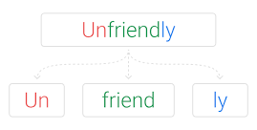
Tokenization — Word, Sentence, and Subword Tokenization
3. Subword Tokenization
Splits words into meaningful subunits (subwords)
Handles rare words or morphologically complex languages
Example:
"unhappiness" → ['un', 'happi', 'ness']
Tools: Byte Pair Encoding (BPE), WordPiece, SentencePiece (used in BERT, GPT, etc.)
Importance:
Accurate tokenization improves model performance
Choice of method depends on the task and language
Instructor : Fawad Bahadur

Slide 22
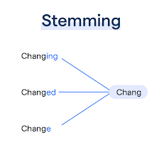
Stemming and Lemmatization
Overview
Both techniques reduce words to their root forms, but they differ in method and accuracy.
1. Stemming
Removes suffixes/prefixes to get the root form
May produce non-dictionary words
Example:
"playing", "played", "plays" → "play"
"studies" → "studi"
Tools: PorterStemmer, SnowballStemmer (NLTK)
Faster but less accurate

Slide 23
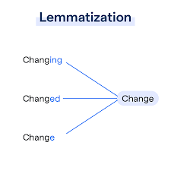
Stemming and Lemmatization
2. Lemmatization
Converts words to their base or dictionary form (lemma)
Requires context (POS tagging)
Example:
"running" → "run"
"better" → "good"
Tools: WordNetLemmatizer (NLTK), spaCy
Slower but more accurate
Use Case:
Choose stemming for speed-sensitive tasks, and lemmatization for accuracy-sensitive NLP tasks.

Slide 24
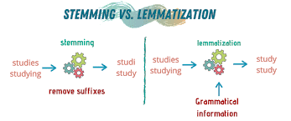
Stemming and Lemmatization
Feature | Stemming | Lemmatization
Output | Root (may be invalid) | Dictionary word
Accuracy | Lower | Higher
Speed | Faster | Slower
Context needed | No | Yes

Slide 25
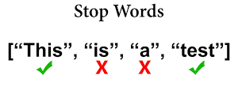
Stop Word Removal
What are Stop Words?
Commonly used words in a language that carry little meaningful information
Examples: "the", "is", "in", "and", "to", "of“
Why Remove Stop Words?
Reduce noise in text data
Improve performance of NLP models by focusing on important words
Reduce dimensionality of data

Slide 26

Stop Word Removal
How to Remove Stop Words?
Use predefined stop word lists available in NLP libraries like NLTK, spaCy
Customize stop word lists based on domain or task
Example:
Original sentence:
"The quick brown fox jumps over the lazy dog."
After stop word removal:
"quick brown fox jumps lazy dog."
Considerations:
Sometimes stop words carry important context (e.g., negations like "not")
Always evaluate impact on your specific task before removal
Common Tools:
NLTK's stopwords corpus
spaCy’s default stop words

Slide 27
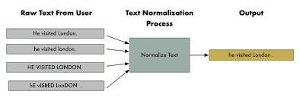
Text Normalization
What is Text Normalization?
Process of transforming text into a standard, consistent format
Helps improve accuracy of NLP tasks by reducing variation
Key Aspects:
Handling Contractions: Expanding shortened forms
- e.g., "don't" → "do not"
- "I'm" → "I am"
Managing Slang and Informal Language
- e.g., "gonna" → "going to"
- "lol" → "laughing out loud"

Slide 28


Text Normalization
Why Normalize Text?
Reduces vocabulary size
Helps models better understand meaning
Essential for noisy user-generated content (tweets, chats)
Techniques:
Rule-based replacement dictionaries
Regular expressions for pattern matching
Pre-trained normalization models
Example:
Original: "I'm gonna grab some food, lol!"
Normalized: "I am going to grab some food, laughing out loud!"
Tools:
Python libraries: contractions, textblob
Custom mappings for domain-specific slang

Slide 29
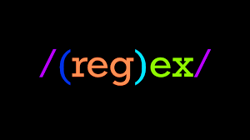
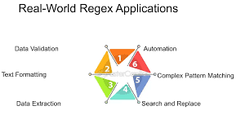
Regular Expressions for Text Processing
What are Regular Expressions (Regex)?
Powerful patterns used to search, match, and manipulate text
Essential tool for text cleaning and preprocessing in NLP
Common Uses in NLP:
Finding specific words or patterns
Extracting email addresses, URLs, phone numbers
Removing unwanted characters or symbols
Splitting text into tokens based on patterns

Slide 30
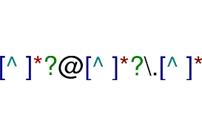
Regular Expressions for Text Processing
Basic Regex Syntax:
. : Any character (a.b → acb, a9b, a-b)
\d : Digit (0-9) (\d\d\d → 123, 231, 987)
\w : Word character (letters, digits, underscore) (\w\w\w → abc, a98, Zb_)
* : Zero or more repetitions (lo*l → ll, lol, loool)
+ : One or more repetitions (lo+l → lol, looool)
[] : Character set (e.g., [aeiou]) (gr[ea]y → gray, grey)
^ : Start of string (^Hello → Hello World)
$ : End of string (end$ → the very end)
Example:
Pattern to find all email addresses:
\b[A-Za-z0-9._%+-]+@[A-Za-z0-9.-]+\.[A-Za-z]{2,}\b
Remove all digits from text:
re.sub(r'\d+', '', text)

Slide 31
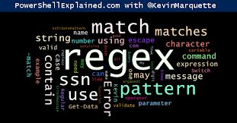
Regular Expressions for Text Processing
Python Regex Module:
import re
Functions: re.search(), re.match(), re.findall(), re.sub()
Why Use Regex?
Flexible and efficient text pattern matching
Speeds up preprocessing steps for NLP pipelines

Slide 32
THANK YOU

